Slide 1

PARALLEL PROGRAMMING...
Copyright 2023 Patrick Lemoine. All rights reserved.

Slide 2

Parallel Programming: Overview
SESSION 2/3
GOAL
Programming Interface for parallel computing
MPI (Message Passing Interface)
OpenMP (Open Multi-Processing)

Slide 3
Programming interface for parallel computing
병렬 컴퓨팅을 위한 프로그래밍 인터페이스

Slide 4

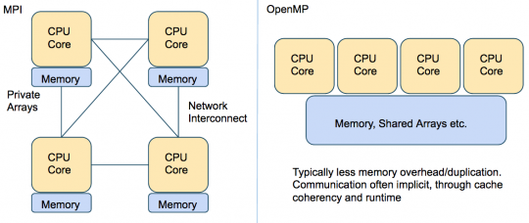
Programming interface…
Remember
.
.
MPI (Message Passing Interface) is a multi-process model whose mode of communication between the processes is explicit.
==> communication management is the responsibility of the user.
.
OpenMP (Open Multi-Processing) is a multitasking model whose mode of communication between tasks is implicit
==> communications is the responsibility of the compiler.

Slide 5



MPI (Message Passing Interface)

Slide 6

MPI (Message Passing Interface)
MPI is a library of subroutines (in Fortran,C, C++)
Allows the coordination of a program running as multiple processes in a distributed-memory environment.
Flexible enough to also be used in a shared-memory environment.
Can be used and compiled on a wide variety of single platforms or (homogeneous or heterogeneous) clusters of computers over a network.
The scalability of MPI is not limited by the number of processors/cores on one computation node, as opposed to shared memory parallel models.
MPI library is standardized, should work (without further changes!)
on any machine on which the MPI library is installed.

Slide 7

MPI: Basic Environment
MPI programs start with a function call which initializes the message passing library.
Initializes MPI environment
Must be called in every MPI program
Must be first MPI call
Can be used to pass command line arguments to all
Terminates MPI environment
Last MPI function call

Slide 8
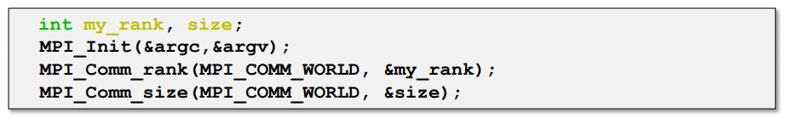
MPI: Basic Environment
Returns the rank of the calling MPI process
Within the communicator, comm
MPI_COMM_WORLD is set during Init(...)
Other communicators can be created if needed
Returns the total number of processes
Within the communicator, comm

Slide 9
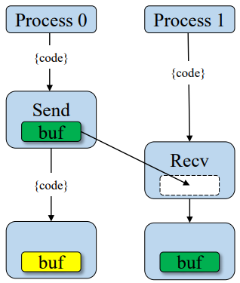
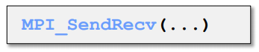
MPI: Point-to-Point Communication
Send a message
Returns only after buffer is free for reuse
Blocking
Received a message
Returns only when the data is avaible
Blocking
Two way communication
Blocking

Slide 10
MPI: Point-to-Point Communication
Blocking
Only returns after completed
- Received: data has arrived and ready to use
- Send: safe to reuse sent buffer
Be aware of deadlocks !!!
Tip: use when possible
Non-Blocking
returns immediately
- Unsafe to modify buffers until operation is known to be complete
Allows computation and communication to overlap
Tip: Use only when needed

Slide 11
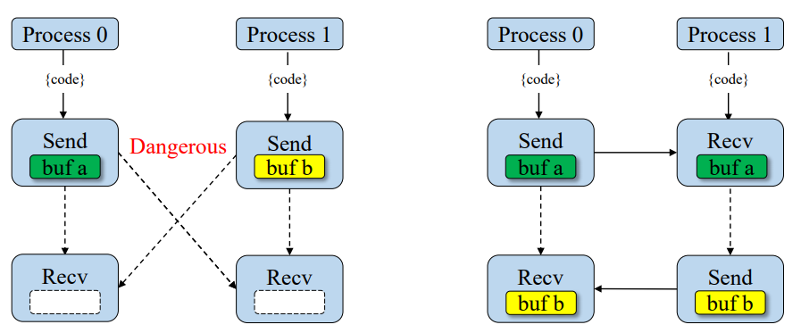
MPI: Deadlock
Blocking calls can results in deadlock
One process is waiting for message that will never arrive
Only option is to abort the interrupt/kill the code (CTRL-c)
Might not always deadlock - depends on size of system buffer

Slide 12
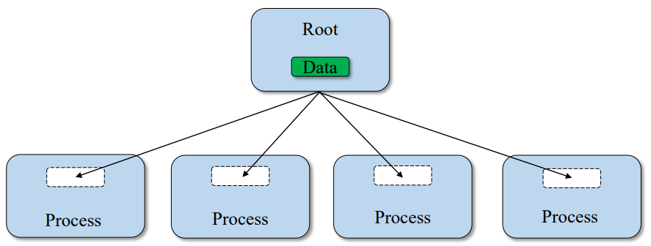
MPI: Coolective Communication (BCast)
Broadcast a message from the root process to all other processes.
Useful when reading in input parameters from file.

Slide 13
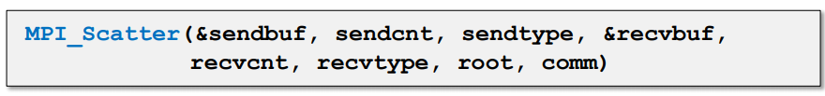
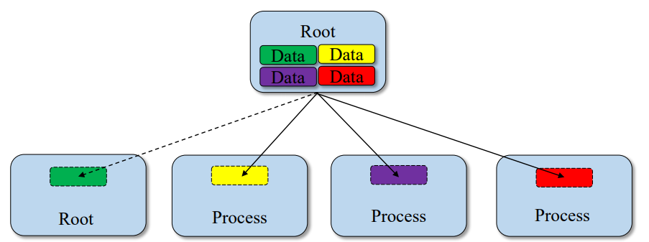
MPI: Collective Communication (Scatter)
Sends individual messages from the root process to all other processes.

Slide 14
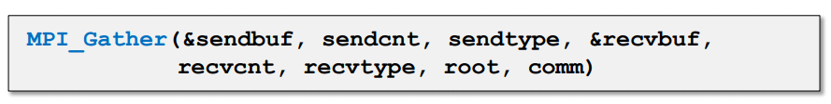
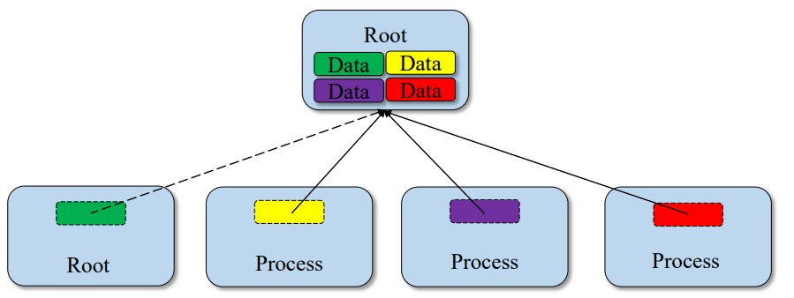
MPI: Collective Communication (Gather)
Opposite of Scatter.

Slide 15
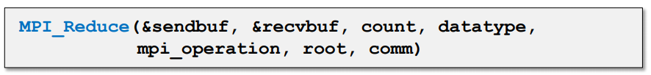
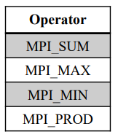
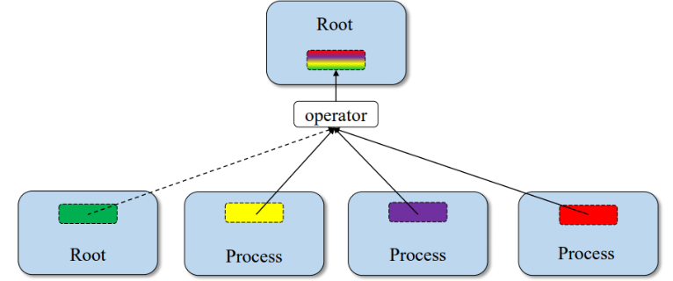
MPI: Collective Communication (Reduce)
Applies reduction operation on data from all processes.
Puts results on root process.

Slide 16
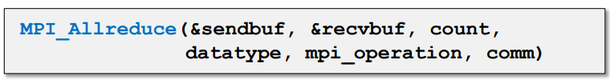
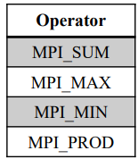
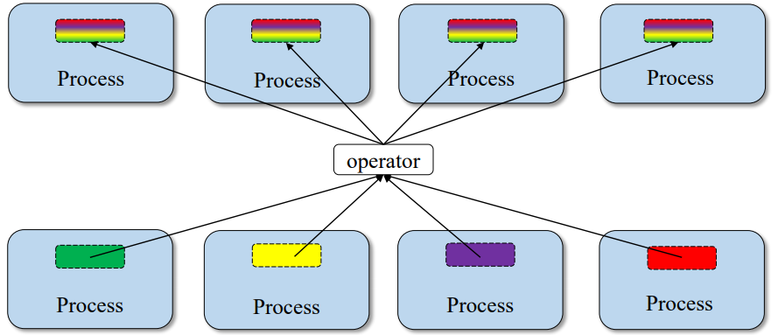
MPI: Collective Communication (Allreduce)
Applies reduction operation on data from all processes.
Store results on all processes.

Slide 17
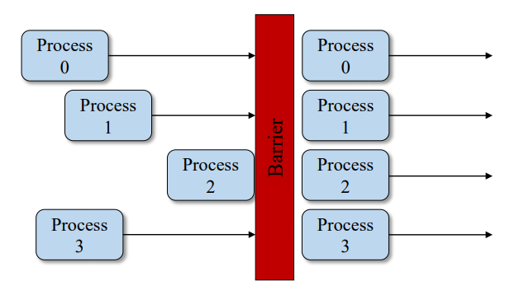
MPI: Collective Communication (Barrier)
Process synchronization (blocking).
All processes forced to wait for each other.
Use only where necessary.
Will reduce parallelism.

Slide 18

MPI: keywords
1 environment • MPI Init: Initialization of the MPI environment • MPI Comm rank: Rank of the process • MPI Comm size: Number of processes • MPI Finalize: Deactivation of the MPI environment • MPI Abort: Stopping of an MPI program • MPI Wtime: Time taking 2 Point-to-point communications • MPI Send: Send message • MPI Isend: Non-blocking message sending • MPI Recv: Message received • MPI Irecv: Non-blocking message reception • MPI Sendrecv and MPI Sendrecv replace: Sending and receiving messages • MPI Wait: Waiting for the end of a non-blocking communication • MPI Wait all: Wait for the end of all non-blocking communications | 3 Collective communications • MPI Bcast: General broadcast • MPI Scatter: Selective spread • MPI Gather and MPI Allgather: Collecting • MPI Alltoall: Collection and distribution • MPI Reduce and MPI Allreduce: Reduction • MPI Barrier: Global synchronization 4 Derived Types • MPI Contiguous type: Contiguous types • MPI Type vector and MPI Type create hvector: Types with a con-standing • MPI Type indexed: Variable pitch types • MPI Type create subarray: Sub-array types • MPI Type create struct: H and erogenous types • MPI Type commit: Type commit • MPI Type get extent: Recover the extent • MPI Type create resized: Change of scope • MPI Type size: Size of a type • MPI Type free: Release of a type

Slide 19
MPI: Keywords
5 Communicator • MPI Comm split: Partitioning of a communicator • MPI Dims create: Distribution of processes • MPI Cart create: Creation of a Cart ́esian topology • MPI Cart rank: Rank of a process in the Cart ́esian topology • MPI Cart coordinates: Coordinates of a process in the Cart ́esian topology • MPI Cart shift: Rank of the neighbors in the Cart ́esian topology • MPI Comm free: Release of a communicator 6 MPI-IO • MPI File open: Opening a file • MPI File set view: Changing the view • MPI File close: Closing a file 6.1 Explicit addresses • MPI File read at: Reading • MPI File read at all: Collective reading • MPI File write at: Writing | 6.2 Individual pointers • MPI File read: Reading • MPI File read all: collective reading • MPI File write: Writing • MPI File write all: collective writing • MPI File seek: Pointer positioning 6.3 Shared pointers • MPI File read shared: Read • MPI File read ordered: Collective reading • MPI File seek shared: Pointer positioning 7.0 Symbolic constants • MPI COMM WORLD, MPI SUCCESS • MPI STATUS IGNORE, MPI PROC NULL • MPI INTEGER, MPI REAL, MPI DOUBLE PRECISION • MPI ORDER FORTRAN, MPI ORDER C • MPI MODE CREATE,MPI MODE RONLY,MPI MODE WRONLY

Slide 20
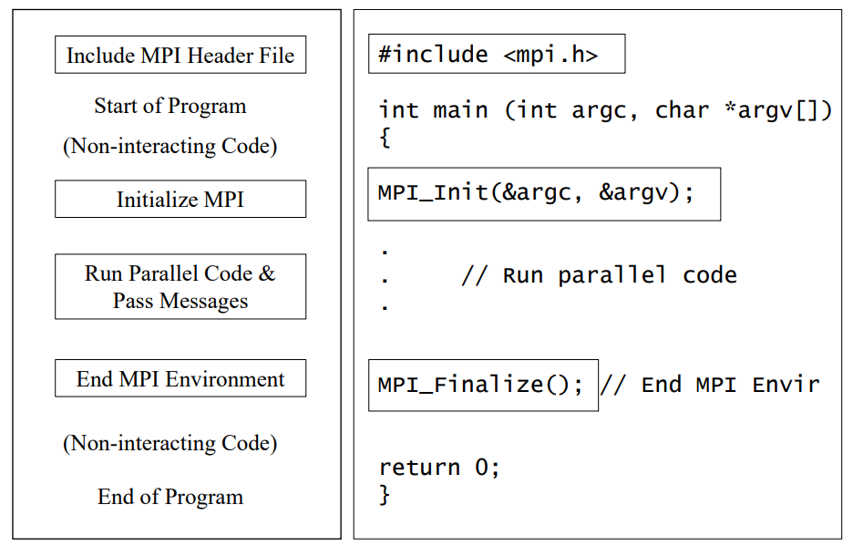
MPI: Program Basics

Slide 21
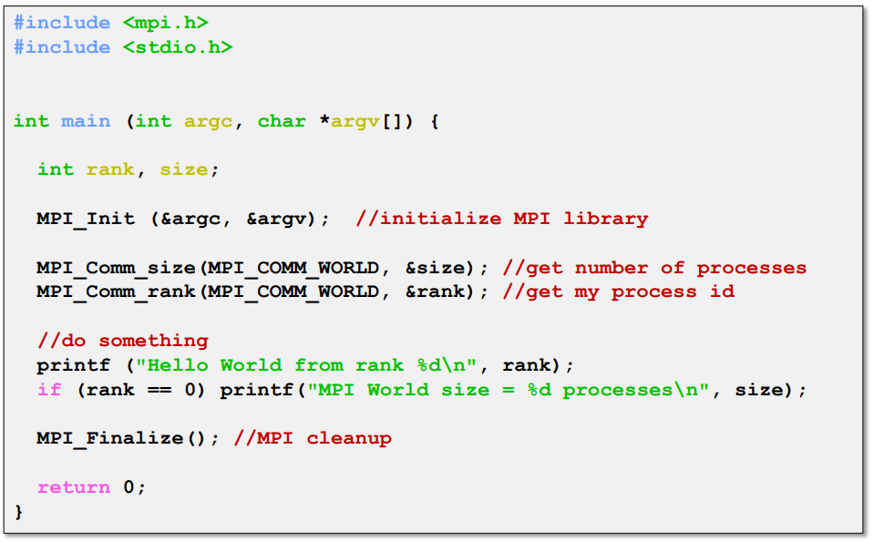
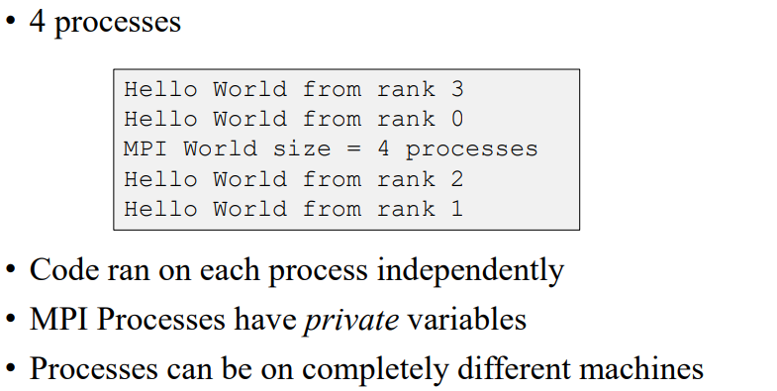
MPI: Example

Slide 22
MPI: Example Broadcast
#include<iostream>
#include<mpi.h>
using namespace std;
int main (int argc, char *argv[])
{
int numprocs,myid,namelen;
char processor_name[MPI_MAX_PROCESSOR_NAME];
MPI_Init(&argc,&argv);
MPI_Comm_size(MPI_COMM_WORLD,&numprocs);
MPI_Comm_rank(MPI_COMM_WORLD,&myid);
MPI_Get_processor_name(processor_name,&namelen);
double reel=(double) myid;
cout<<"Before " <<myid<<" of "<<numprocs<<" on "<<processor_name<<" integervalue "<<reel<<endl;
MPI_Bcast(&reel,1, MPI_DOUBLE,3,MPI_COMM_WORLD);
MPI_Barrier( MPI_COMM_WORLD);
cout<<"After " <<myid<<" of "<<numprocs<<" on "<<processor_name<<" integervalue "<<reel<<endl;
MPI_Finalize();
exit(0);
}
Broadcast a message from the root process to all other processes.
Useful when reading in input parameters from file.

Slide 23
MPI: Example Point-to-Point communication
#include<iostream>
#include<mpi.h>
using namespace std;
int main (int argc, char *argv[])
{
int numprocs,myid;
MPI_Init(&argc,&argv);
MPI_Comm_size(MPI_COMM_WORLD,&numprocs);
MPI_Comm_rank(MPI_COMM_WORLD,&myid);
MPI_Status status;
int small=myid;
cout<<"Before " <<myid<<" of "<<,numprocs<<" small = "<<small,<<endl;
If (myid==0) { MPI_Send(&small,1,MPI_INT,3,10,MPI_COMM_WORLD); }
If (myid==3) { MPI_Recv(&small,1,MPI_INT,0,10,MPI_COMM_WORLD,&status) }
MPI_Barrier( MPI_COMM_WORLD);
cout<<"After " <<myid<<" of "<<numprocs<<" small = "<<small<<endl;
MPI_Finalize();
}

Slide 24
MPI: Example Reduction
...
#include<mpi.h>
using namespace std;
double f( double a ) {return (4.0 / (1.0 + a*a));}
int main (int argc, char *argv[])
{
int myid, numprocs;
MPI_Init(&argc,&argv);
MPI_Comm_size(MPI_COMM_WORLD,&numprocs);
MPI_Comm_rank(MPI_COMM_WORLD,&myid);
int n = 1000000000;
double pi,sum=0.0;
double startwtime = 0.0;
if (myid == 0) { startwtime = MPI_Wtime(); }
MPI_Bcast(&n, 1, MPI_INT, 0, MPI_COMM_WORLD);
for (int i = myid + 1; i <= n; i += numprocs) { sum += f((i-0.5)/(double) n); }
sum/= (double) n;
MPI_Reduce(&sum, &pi, 1, MPI_DOUBLE, MPI_SUM, 0, MPI_COMM_WORLD);
if (myid == 0)
{
cout<<"pi is approximately equal "<<setprecision(16) << pi <<" Error is"<<fabs(pi - M_PI)<<endl;
cout<<"Wall clock time = "<<MPI_Wtime()-startwtime<<endl;
}
MPI_Finalize();
Exit(0);
}
GOAL : The following code computes the π number by using a numerical evaluation of an integral by a rectangle method.
Each virtual core computes a part of the loop and a reduction instruction is performed

Slide 25
COMPILING an MPI Program
Compiling a program for MPI is almost just like compiling a regular C or C++ program
The C compiler is mpicc and the C++ compiler is mpic++.
For example, to compile MyProg.c you would use a command like
mpicc - O2 -o MyProg MyProg . c

Slide 26

OpenMP (Open Multi-Processing)

Slide 27


OpenMP (Open Multi-Processing)
OpenMP is a programming interface for parallel computing on shared memory architecture.
The OpenMP API consists of
compiler directives (for insertion into sequential Fortran/C/C++$code)
a few library routines
some environment variables
Advantages:
User-friendly
Incremental parallelization of a serial code
Possible to have a single source code for both serial and parallelized versions
Disadvantages:
Relatively limited user control
Most suitable for parallelizing loops (data parallelism)
Performance?

Slide 28
OpenMP (Open Multi-Processing)
OpenMP is a programming interface for parallel computing on shared memory architecture.
It allows you to manage:
the creation of light processes
the sharing of work between these lightweight processes
synchronizations (explicit or implicit) between all light processes
the status of the variables (private or shared).

Slide 29
OpenMP (Open Multi-Processing)
Shared memory model
Threads communicate by accessing shared variables
The sharing is defined syntactically
Any variable that is seen by two or more threads is shared
Any variable that is seen by one thread only is private
Race conditions possible
Use synchronization to protect from conflicts
Change how data is stored to minimize the synchronization

Slide 30
OpenMP (Open Multi-Processing)
Multicore CPUs are everywhere:
Servers with over 100 cores today and more
Even smartphone CPUs have 8 cores
Multithreading, natural programming model
All processors share the same memory
Threads in a process see same address space
Many shared-memory algorithms developed
Multithreading is hard
Lots of expertise necessary
Deadlocks and race conditions
Non-deterministic behavior makes it hard to debug

Slide 31
OpenMP: Process and thread: whatis the difference ?
You need an existing process to create a thread.
Each process has at least one thread of execution.
A process has its own virtual memory space that cannot be accessed by other processes running on the same or on a different processor.
All threads created by a process share the virtual address space of that process. They read and write to the same address space in memory. They also share the same process and user ids, file descriptors, and signal handlers. However, they have their own program counter value and stack pointer, and can run independently on several processors.

Slide 32
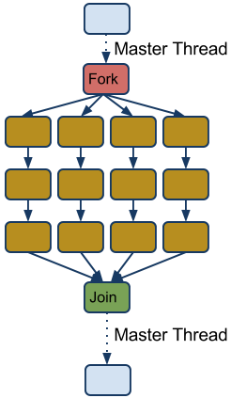
OpenMP: Terminology and behavior
OpenMP Team = Master + Worker
Parallel Region is a block of code executed by all threads simultaneously (has implicit barrier)
The master thread always has thread id 0
Parallel regions can be nested
If clause can be used to guard the parallel region

Slide 33



OpenMP: General Code Structure
#include <omp.h>
main ()
{
int var1, var2, var3;
//serial code
//start of a parallel region
#pragma omp parallel private(var1, var2) shared(var3)
{...}
//more serial code
{...}
//another parallel region
#pragma omp parallel
{…}
}

Slide 34
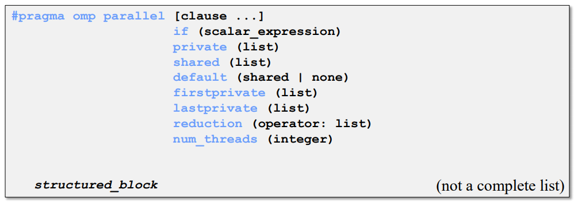
OpenMP: Constructs
Parallel region
Thread creates team, and becomes master (id 0)
All threads run code after
Barrier at end of parallel section

Slide 35
OpenMP: Parallel Clauses
Only execute in parallel.
Otherwise serial.
Data local to thread.
Value are not guaranted to be defined on exit (even if defined before)
No storage associated with original object
Use firstprivate and/or lastprivate clause to override
Variables in list are private.
Initialized with the value the variable had before entering the construct.
Only in for loops
Variables in list are private.
The thread that executes the sequentially last iteration updates the value of the variables in the list.

Slide 36
OpenMP: Parallel Clauses
Data is accessible by all threads in team.
All threads access same address space.
Improperly scoped variables are big source of OMP bugs
- Shared when should be private
- Race condition
Tip: Safest is to use default (none) and declare by hand.

Slide 37
OpenMP Barrier
When a thread reaches a barrier it only continues after all the threads in the same thread team have reached it
Each barrier must be encountered by all threads in a team, or none at all
The sequence of work-sharing regions and barrier regions encountered must be same for all threads in team
Implicit barrier at the end of: do, parallel, single, workshare

Slide 38
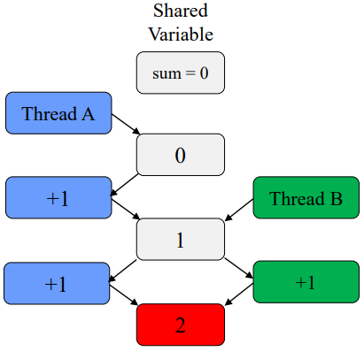
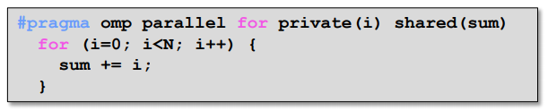
OpenMP: Caution Race Condition
When multiple threads simultaneously read/write
Multiple OMP solutions
- Reduction
- Atomic
- Critical
Should be 3!

Slide 39
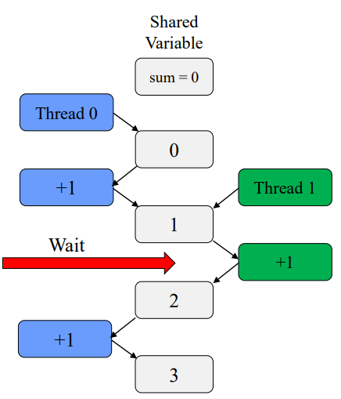
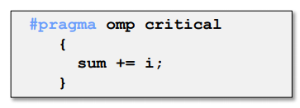
OpenMP: Critical Section
One solution: use critical
Only one tread at a time can execute a critical section
Downside ?
SLOOOOWWW
Overhead and serialization

Slide 40
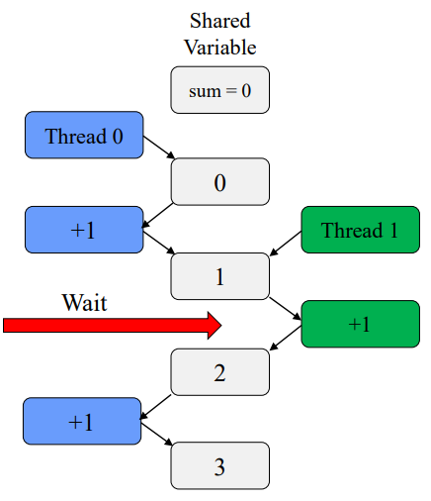
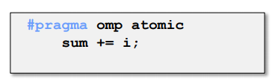
OpenMP: Atomic
Atomics like "mini" critical
Only one line
Certain limitations
Hardware controlled
Less overhead the critical

Slide 41
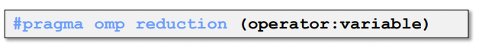
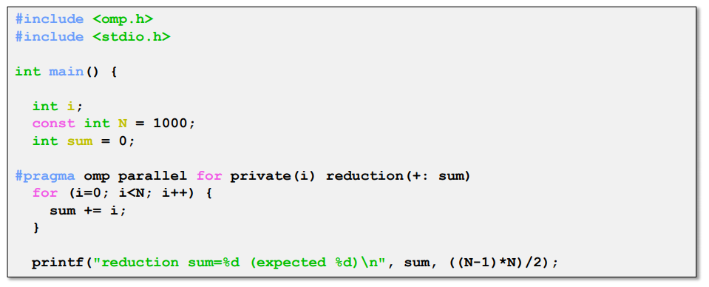
OpenMP: Reduction
Avoids race condition
Reduce variable must be shared
Makes variable private, then performs operator at end of loop
operator cannot be overloaded (c++)
One of: +,*,-,/ (and &,^,|,&&,||)
OpenMP 3.1: added min and max for c/c++

Slide 42
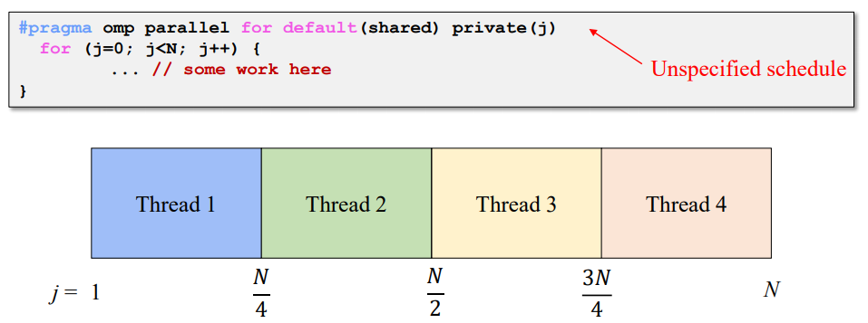
OpenMP: Scheduling omp for
How does a loop get split up ?
In MPI, we have to do it manually
If you do not tell what to do, the compiler decides
Usually compiler chooses "static" - chunks of N/p

Slide 43
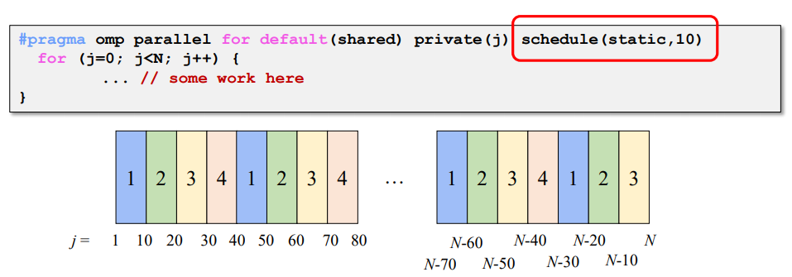
OpenMP: Static Scheduling
You can tell the compiler what size chunks to take.
Keeps assigning chunks until done.
Chunk size that is not a multiple of the loop will results in thread with uneven numbers.

Slide 44
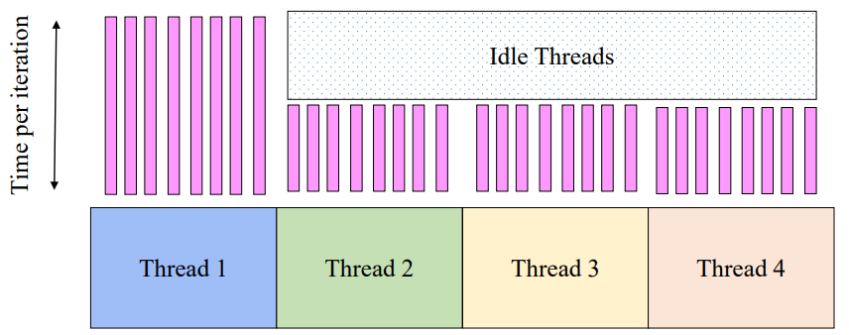
OpenMP: Problem with Static Scheduling
What happens if loop iterations do not take the same amount of time ?
Load imbalance

Slide 45
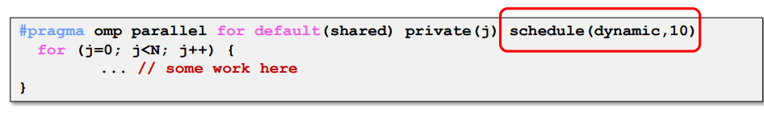
OpenMP: Dynamic Scheduling
Chunks are assigned on the fly, as threads become available
When a thread finishes on chunk, it is assigned another
Caveat: higher overhead than static!

Slide 46
OpenMP: For Scheduling Recap
Scheduling types
Static
- Chunks of specified size assigned round-robin
Dynamic
- Chunks of specified size are assigned when thread finishes previous chunk
Guided
- Like dynamic, but chunks are exponentially decreasing
- Chunk will not be smaller than specified size
Runtime
- Type and chunk determined at runtime via environment variables

Slide 47
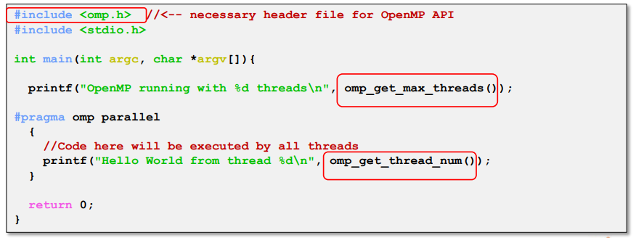
OpenMP: API
API for library calls that perform useful functions
Must include "omp:h"
Will not compile without OpenMP compiler support

Slide 48
OpenMP: API
Sets number of treads used in next parallel section
Overrides OMP_NUM_THREADS environment variable
Positive integer
Returns max possible (generally set by OMP_NUM_THREADS)
Returns number of threads currently in team
Returns thread id of calling thread
Between 0 and omp_get_num_threads-1
Returns number of seconds since some point
Use inpais time=(t2-t1)

Slide 49
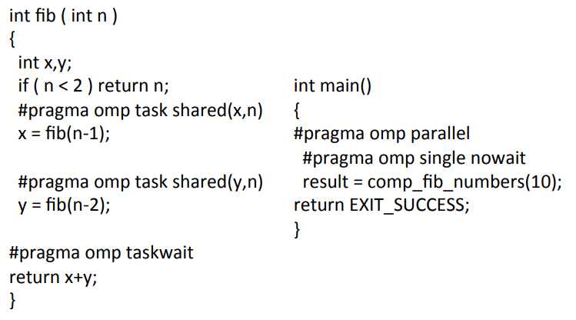
OpenMP: Example Fibonacci

Slide 50
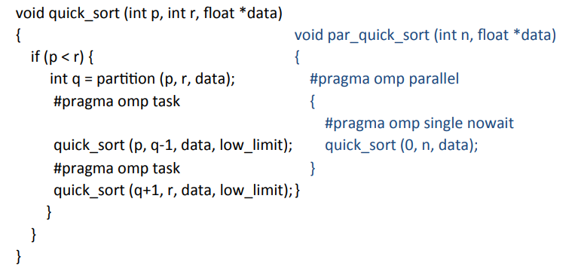
OpenMP: Example Quicksort

Slide 51
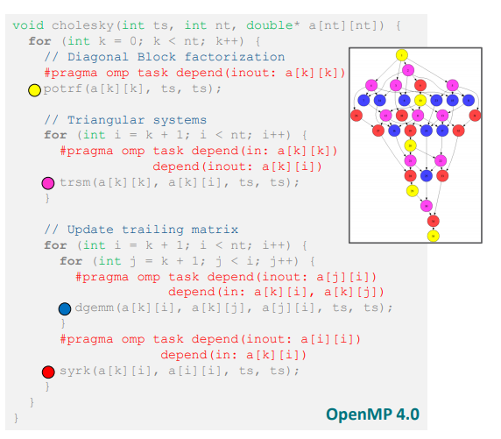
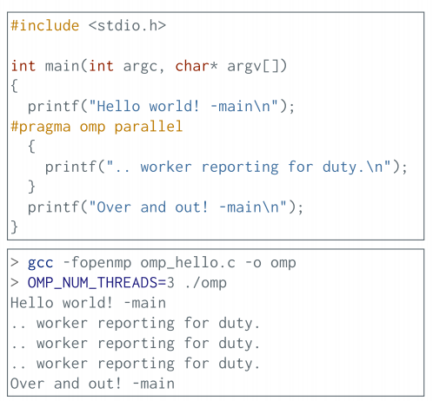
OpenMP: Example Cholesky Factorization

Slide 52
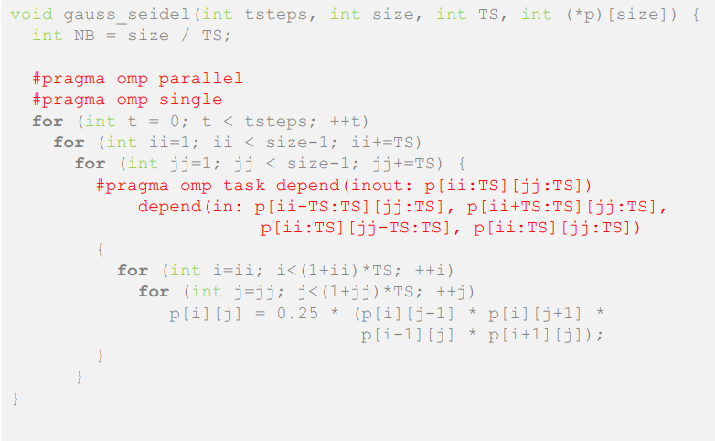
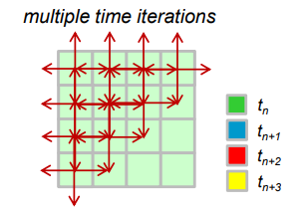
OpenMP: Example Gauss-Seidel
Gauss-Seidel Method is used to solve the linear system Equations. It is a method of iteration for solving n linear equation Ax=b with the unknown variables.

Slide 53
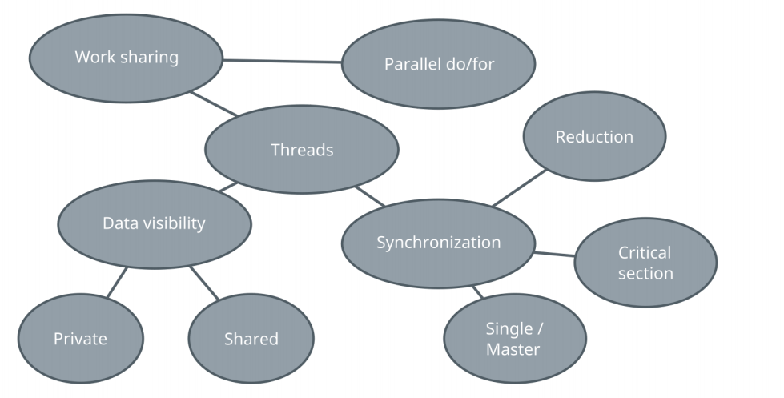
OpenMP: Summary

Slide 54
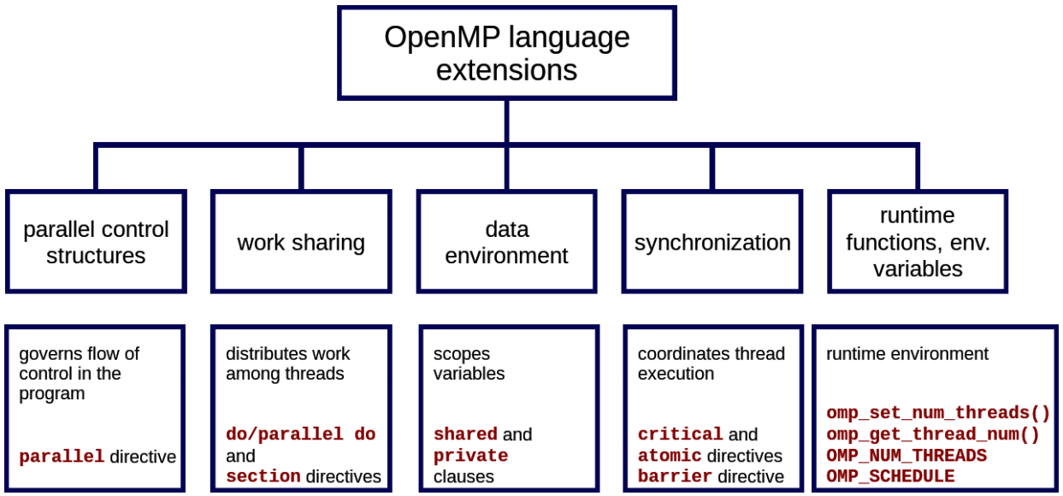
OpenMP: Summary Overview

Slide 55
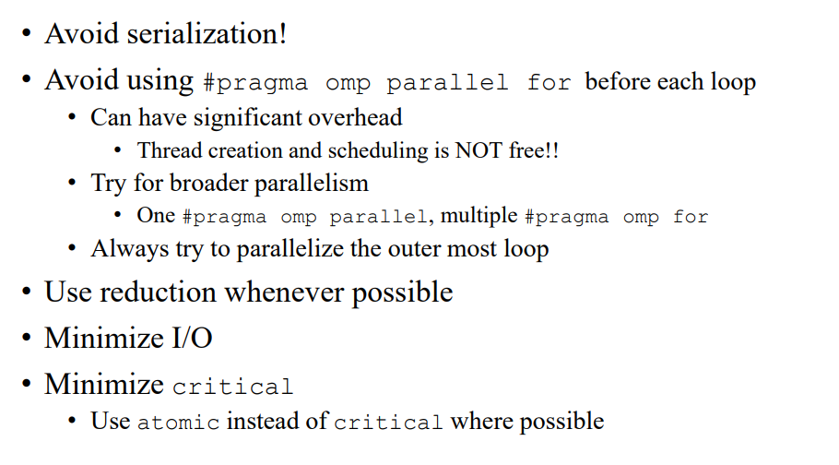

OpenMP: Performance Tips

Slide 56
Hybrid OpenMP-MPI

Slide 57
Hybrid MPI and OpenMP
Hybrid application programs using MPI + OpenMP are now common place on large HPC systems.
There are basically two main motivations:
1. Reduced memory footprint, both in the application and in the MPI library (eg communication buffers).
2. Improved performance, especially at high core counts where pure MPI scalability runs out.

Slide 58
Hybrid MPI and OpenMP
Parallel programming models
Parallel execution is based on threads or processes (or both) which run at the same time on different CPU cores
Processes
- Interaction is based on exchanging messages between processes
- MPI (Message passing interface)
Threads
- Interaction is based on shared memory, i.e. each thread can access directly other threads data
- OpenMP

Slide 59
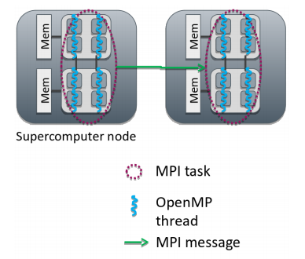
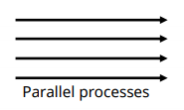
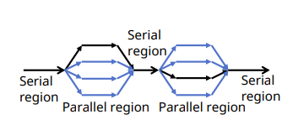
Hybrid MPI and OpenMP
1: MPI: Processes
- Independent execution units
- Have their own memory space
- MPI launches N processes at application startup
- Works over multiple nodes
2: OpenMP: Threads
- Threads share memory space
- Threads are created and destroyed (parallel regions)
- Limited to a single node
3: Hybrid programming: Launch threads (OpenMP) within processes (MPI)
- Shared memory programming inside a node, message passing between nodes
- Optimum MPI task per node ratio depends on the application and should always be experimented.

Slide 60
Hybrid Programming
In hybrid programming each process can have multiple threads executing simultaneously
All threads within a process share all MPI objects Communicators, requests, etc.
MPI defines 4 levels of thread safety:
MPI_THREAD_SINGLE : One thread exists in program
MPI_THREAD_FUNNELED : Multithreaded but only the master thread can make MPI calls Master is one that calls MPI_Init_thread()
MPI_THREAD_SERIALIZED: Multithreaded, but only one thread can make MPI calls at a time
MPI_THREAD_MULTIPLE: Multithreaded and any thread can make MPI calls at any time. Use MPI_Init_thread instead of MPI_Init if more than single thread

Slide 61
Hybrid Programming
Potential advantages of the hybrid approach
Fewer MPI processes for a given amount of cores
- Improved load balance
- All-to-all communication bottlenecks alleviated
Decreased memory consumption if an implementation uses replicated data
Additional parallelization levels may be available
Possibility for dedicating threads for different tasks
- e.g. dedicated communication thread or parallel I/O
Dynamic parallelization patterns often easier to implement with OpenMP
Disadvantages of hybridization
Increased overhead from thread creation/destruction
More complicated programming
- Code readability and maintainability issues
Thread support in MPI and other libraries needs to be considered

Slide 62
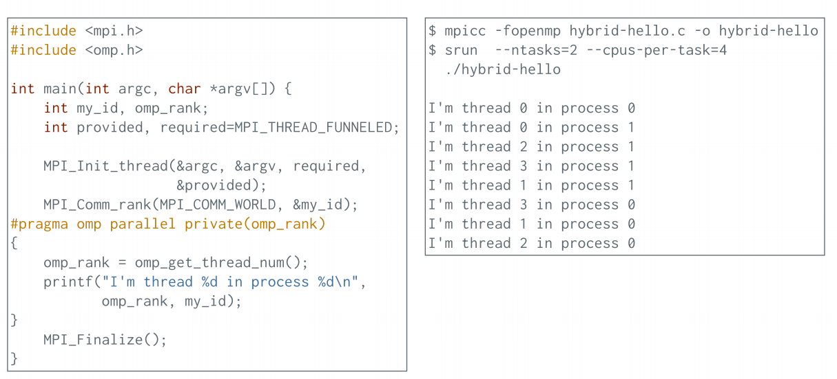
Hybrid Programming: Example

Slide 63
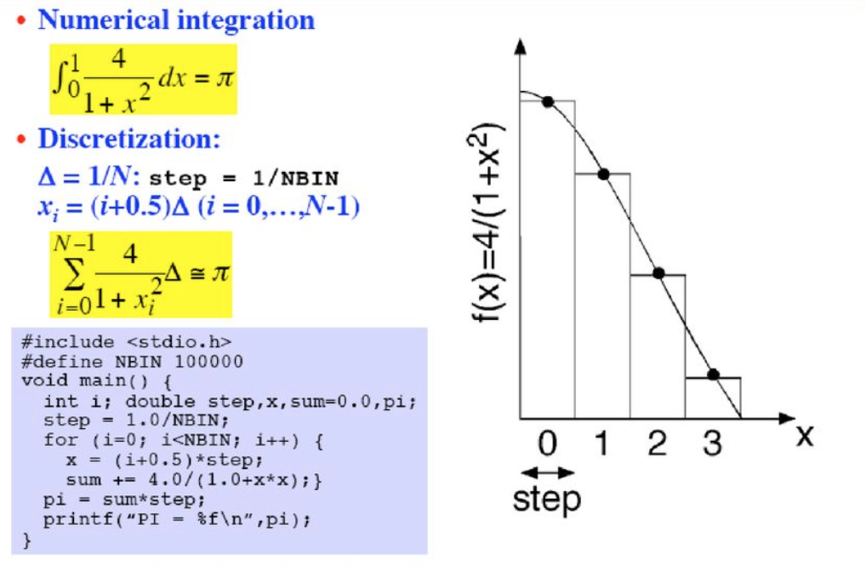
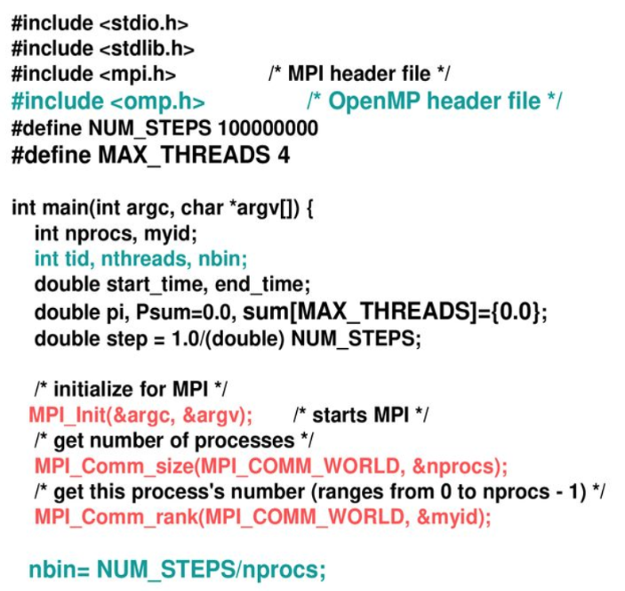
Hybrid Programming Example

Slide 64


Hybrid Programming Example

Slide 65

Thank you for your attention !

